Slide 1

You have visited Prague and now you would like to go further your way.
What do you need for a safe and correct departure from LKPR?
Let our wizzard guide you through the whole* process.
* - procedures described further are aimed only to explain some local operational procedures at LKPR and cannot be considered as complete guidelines or legislative requirements for flight planning, flight preparation or flight execution.
For purposes of flight planning, preparation and execution use AIP ČR, EU-OPS and other official sources which comply with your intended flight.
2

Slide 2
Departure slot
LKPR is a fully coordinated airport, therefore all departures must have a confirmed departure slot, known as the SOBT (Scheduled Off-Block Time).
Do you have your departure slot arranged?
NO
You don't have a departure slot yet – Please contact your local partner and ask them to request the departure slot for you. You can find a list of available handling companies here. Alternatively, you can request the departure slot yourself. Guideline for doing so is available on this website. However, we strongly recommend using your handling provider to ensure the request is submitted correctly.
YES
If your departure slot is already confirmed, you can proceed to the next step.
3

Slide 3
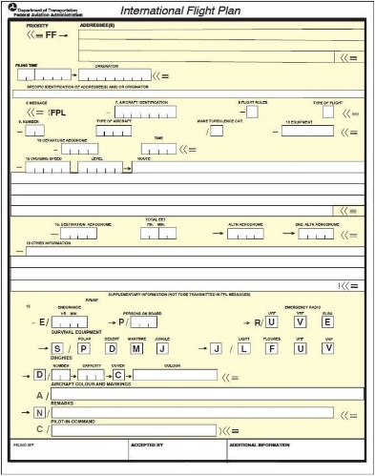
Departure slot
Flight plan
Great, you now have a departure slot (SOBT) arranged. Let's see how it works with the flight plan. Do you need to file a flight plan to depart from Prague?
NO
If you are a VFR flight, you generally don't need to file a flight plan to depart from LKPR.
Please be aware that this only applies for VFR flights flying only through LKPR_CTR (D class airspace) after departure.
If you intend to enter LKPR_TMA (C class airspace) you need to file a flight plan, so please see the instructions below.
YES
If you are a IFR flight or a VFR flight crossing LKPR_TMA after departure, you are required to file a flight plan. There are various ways how to file a flight plan (FPL). Some of them can be found on this website under the FPL filing section. Please keep in mind that your EOBT time in the flight plan must be either the same as your SOBT or maximum 30minutes later (SOBT+30 min).
4
4

Slide 4

Departure slot
Flight plan
Flight rules
Let´s now have a look at whether A-CDM (Airport Collaborative Decision Making) procedures apply to your flight. What are the flight rules of your flight?
You are a VFR departure from LKPR
Your flight is exempt from A-CDM procedures, therefore at the right time you can contact ATC frequency
for start up and departure clearance.
Here the guide ends for you, we wish a safe flight, and we hope to see you again soon!
You are a IFR departure from LKPR
You will most likely be subject to A-CDM procedures.
Let’s take a closer look at what that means for your flight.
5

Slide 5
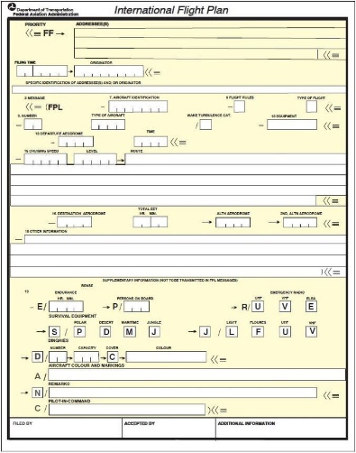
Departure slot
Flight plan
Flight rules
A-CDM exceptions
Let’s check whether your flight is exempt from A-CDM procedures. Did you put one of the following statuses into the field 18 (other information) of your FPL?
STS/MEDEVAC (Medical evacuation)
STS/SAR (Search and Rescue)
STS/HEAD (Head of State)
STS/FFR (Fire Fighting)
YES
If you filled one of the above listed statuses into your FPL, your flight is exempt from A-CDM procedures,
therefore at the right time you can contact ATC for start up and departure clearence.
Here the guide ends for you, we wish a safe flight, and we hope to see you again soon!
NO
If you did not enter one of the exemption statuses listed above in your flight plan, your flight is subject to A-CDM procedures. This means you are required to set a TOBT (Target Off-Block Time). Let’s go over how to set your TOBT in the next step.
6

Slide 6
Departure slot
Flight plan
Flight rules
A-CDM exceptions
TOBT
Because A-CDM procedures apply to your flight, you are required to set a TOBT (Target Off-Block Time) value. This has to be done in close cooperation with your handling agent. Further details can be found here.
Is your TOBT set?
NO
Together with your handling agent you have to make a reasonable time estimate when all conditions defined for
TOBT are met. This time value should then be set as TOBT. As a best practice we recommend using the same value as EOBT. Departure without TOBT is not possible.
YES
Perfect, now you have to wait for your TSAT (Target Start-up Approval Time) allocation by the ATC.
7

Slide 7
Departure slot
Flight plan
Flight rules
A-CDM exceptions
TOBT
TSAT
The TOBT value has been set, therefore you now have to wait for your TSAT (Target Start-up Approval Time) allocation by the ATC. TSAT value determines when you can contact GND for start up.
Do you have a TSAT?
NO
You now need to wait for your TSAT to be calculated. TSAT is generated no earlier than approximately 40 minutes
before your intended start-up time. Your handling provider will inform you of the TSAT as soon as it becomes available.
YES
Now you have to wait until the time set as TSAT. But you have to watch carefully, because if it‘s considerably later than your TOBT it may be incrementally improved down to TOBT value itself!
However TSAT can never be earlier than TOBT. When do I contact GND then?
8

Slide 8

Departure slot
Flight plan
Flight rules
A-CDM exceptions
TOBT
TSAT
Start up
Now all you need to do is wait for the right time to get start up
and departure clearance. But when should you call ATC?
Your flight is A-CDM compliant, therefore you should ask for start up inside the TSAT tolerance window, which is TSAT ±5 minutes.
So if your TSAT is 11:05 and you are in a hurry, your first contact can be earliest at 11:00 sharp. However if you miss 11:10, the TSAT expires, your flight is excluded from the departure sequence and you have to state a new TOBT. That of course means further waiting for a new TSAT.
We hope you found our wizard helpful. Wishing you a safe flight,
and we look forward to welcoming you back soon!

